Slide 1
Geospatial Intelligence Current State Report
K&A Internship Project

Slide 2
Content
Twitter API Developer Account
Limitations
Getting Data
Predicting Location Data
Analyzing The Data

Slide 3
Twitter API Developer Account
Allows access to Twitter API.
3 Account Types
Standard (Free)
Premium (Paid)
Enterprise (Paid)
Provides Access To
Tweets (search, tweets, tweet, retweet, quote, …)
Users (users public data)

Slide 4
Limitation
Standard API (7 days Tweets History).
Premium API (30 days Tweets History).
Enterprise API (Full History – since 2006).
We can’t get old Tweets. (Standard – Premium)
There are limitations on how many requests we can make and number of Tweets we can get. (All – Standard is even more limited)
The API will not help us in getting users location, since most users have their location tagging off by default or on for specific tweets only. (All)
The cost of Premium or Enterprise Account is not affordable, especially in this current economic situation. (Premium – Enterprise)

Slide 5
Getting Data (Tweets)
A possible solution for the previous limitations is to use Scrapping.
We will control Chrome Browser using something called Chrome Driver which allows us to open Chrome and automate tasks on it as if there is a human being using it.
This will also allow us to access old Tweets history since Twitter doesn’t limit the normal Twitter User from accessing them.
There are also some tool that scraps Tweets in another way using other methods.
Both of these methods will be used to get & manage our data.

Slide 6
Predicting Location Data
Tweet Users normally have a general location, which in most cases won’t help much.
Ex: Lebanon
My solution for this is the following:
We get the usernames of the scrapped Tweets.
We scraps each username’s personal Tweets.
We then try to analyze his location from these Tweets content.
Using the frequency of mentioned locations.

Slide 7
Analyzing The Data
Analysis Summary:
Sentiment Analysis
Adding a Negative/Neutral/Positive labels according to the tweet content.
Linking the results to users and their locations.
Displaying the results using ArcGIS Online Dashboard.
Text Mining
Currently In Progress…

Slide 8
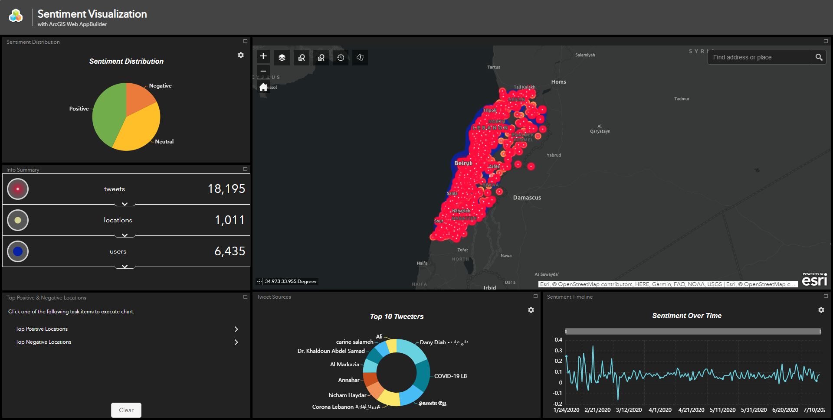
Sentiment Dashboard
1
7
8
9
10
11
6
2
4
5
3

Slide 9
Sentiment Dashboard
Sentiment Distribution (Pie Chart)
Gives a general view on the sentiment distribution in the current map extent.
Info Summary (List)
A summary that shows some info (ex: count) about the visible layers in the current map extent.
Top Positive / Negative Locations (Column Charts)
Allows the viewer to view the locations with most positive or negative sentiment.
Top Tweeters / Top Tweet Sources (Doughnut Chart)
Displays the top 10 users that tweeted the most tweets in the dataset.
Sentiment Over Time (Line Chart )
Displays how the sentiment changed over time.
Base Map
Layer List
Allows to turn on/off layers
User Search
Allows to search for a specific user and displays his different tweets and sentiments.
Location Search
Allows to search for a specific location and view it’s specific sentiment.
Time Slider
Allows to play day by day data and display it on the map.
Proximity Search
Allows to get the nearest users and locations according to the a specific point the viewer chooses.

Slide 10
Sentiment Dashboard
The dashboard contains 3 sections:
The Base Map (6) where the layers are displayed.
The Outer Widgets (1-5) which include a general view on the data.
The Inner Widgets (7-11) which provides additional functions that help the viewer search for specific data.
The aim of this dashboard is to provide both general and specific data that can help the viewer get the general conclusion of the data or dig deep into it for more insights.
The dashboard is still under review, but this is the basic idea of what we will show for sentimental analysis.

Slide 11
Sentiment Dashboard
The dashboard contains 3 sections:
The Base Map (6) where the layers are displayed.
The Outer Widgets (1-5) which include a general view on the data.
The Inner Widgets (7-11) which provides additional functions that help the viewer search for specific data.
The aim of this dashboard is to provide both general and specific data that can help the viewer get the general conclusion of the data or dig deep into it for more insights.
The dashboard is still under review, but this is the basic idea of what we will show for sentimental analysis.

